Slide 1
Data Craft: The Manipulation of Social Media Metadata by Acker, A.
Naga Vamsi Krishna Pabbisetty
Web Archiving Forensics (CS 795/895)
Old Dominion University
2019/04/17

Slide 2
Manipulation of Data
Celebrities/Politicians – famous/popular
Generate clicks/fake engagement through astroturfing and botnets
International marketplace for followers/clicks to promote celebrity profiles/fake reviews/followers/views/others
Platforms respond by locking down, deleting accounts with “bot sweeps” and the mass deletion of fake accounts
Moderation of politically motivated manipulation has proven difficult

Slide 3
Problem being faced
Discerning if a user is real and their activities are authentic from fake/spammy/malicious manipulations

Slide 4
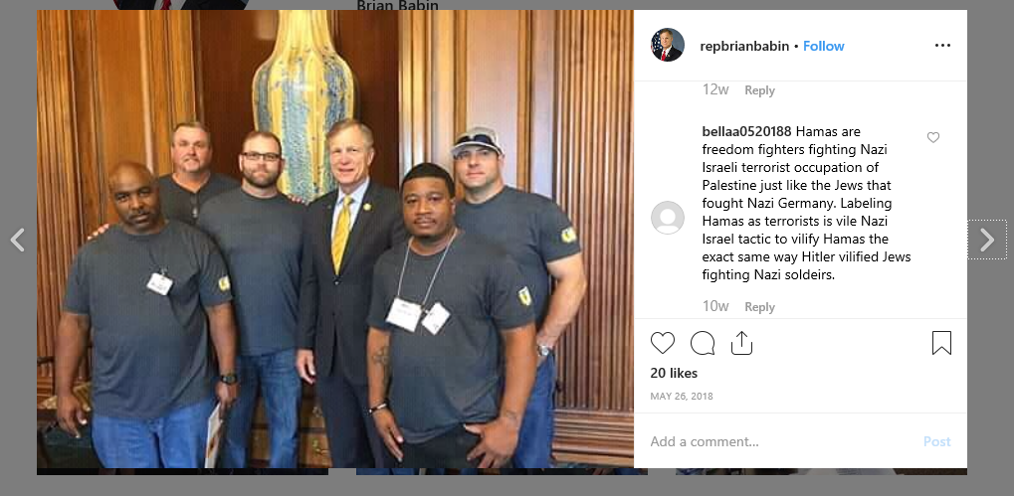




Differentiating Content and Metadata
Content – Photo, Post
Metadata - Account Image, Account Name, Number of Likes, Tag, Date of Post
Additional Metadata from the API
location_id
profile_views
created_time
source
https://www.instagram.com/p/BjPcVlcH9QM/

Slide 5
Uses of Metadata
Useful in different places in different ways
In case of retrieving information from databases, traversal through network and accessing almost every account on every platform, metadata is required
Plays a major role in providing user experience
Can be used to find/retrieve an event/post in a timeline (date, time and user id/profile handle)
Gives a new perspective to look at as new ways are required

Slide 6
The Need to read metadata
Using metadata to validate or dispute media data would help in understanding data manipulation and data manipulators
This would help the platforms in their challenge against falsified content

Slide 7
One Person’s Metadata Are Another Person’s Data
Metadata is defined in different ways
Distinction is usually based on collection, creation and use
Context based distinction of metadata cannot always be used as it changes over time
It also varies from user to user and their purpose

Slide 8
Aleksandr Kogan’s “This Is Your Digital Life” App
Cambridge Analytica breach
Collected user profile data from Facebook
Also collected data about friends (as part of metadata as per then facebook norms)
Collected data on millions of users without their interaction
Stopped collecting data in 2014 (after an update by Facebook)
Reason – borderline differentiation between data and metadata

Slide 9
Data Craft
The necessary skills required for the manipulation of data over to platform using its metadata that can produce disinformation
A group of skills which can create, reply or proliferate data in any platform irrespective of interest

Slide 10
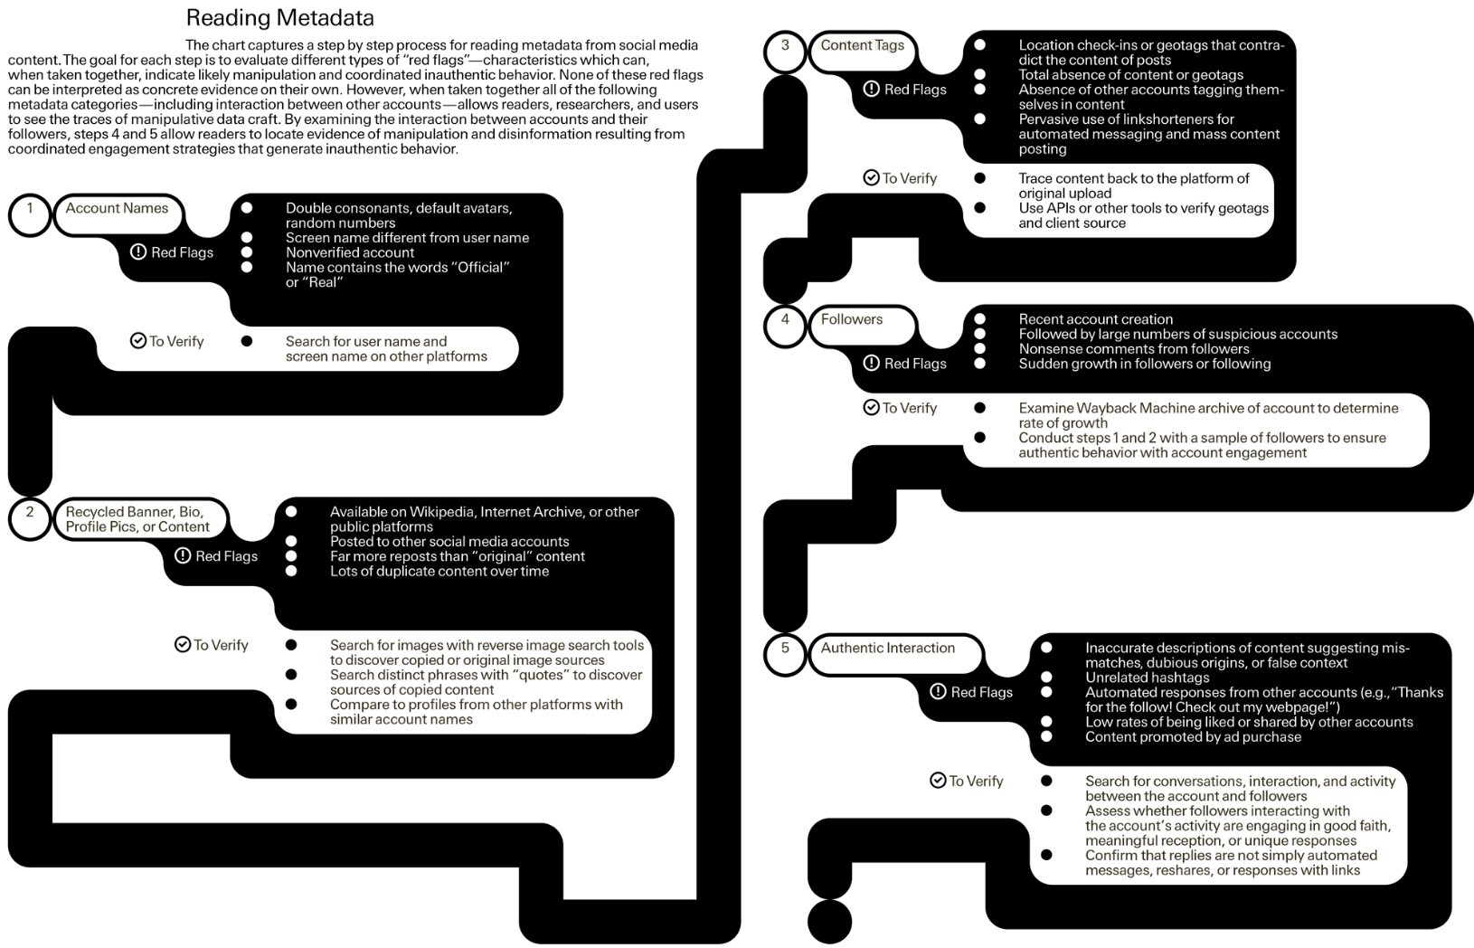
Reading Metadata
Figure:2

Slide 11
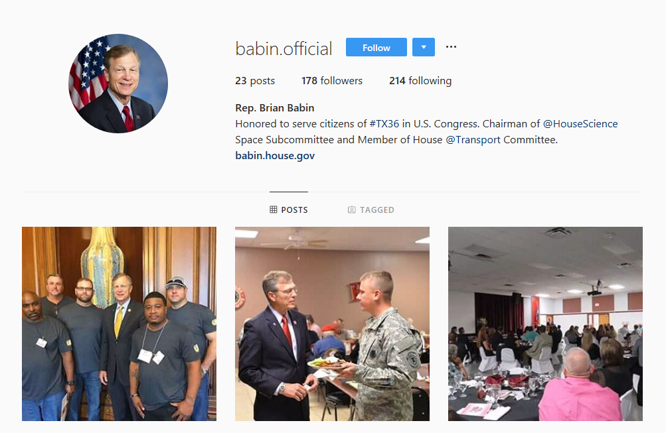
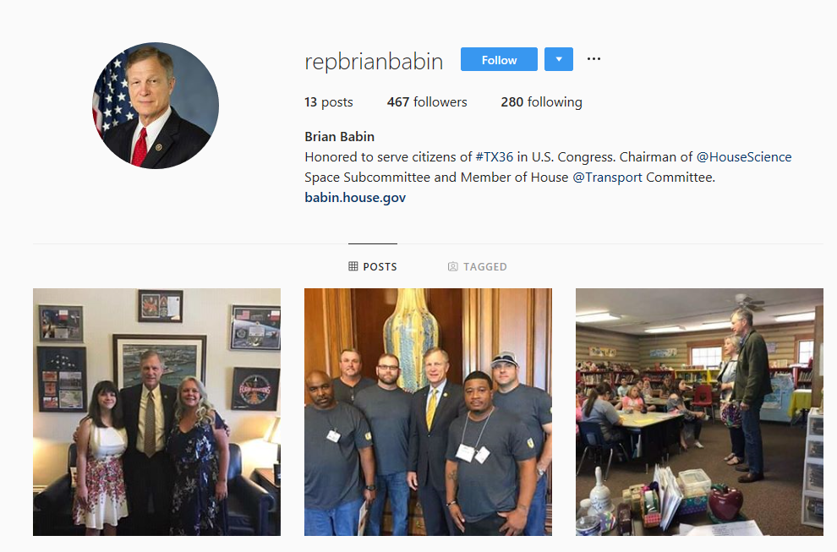
Babin on Instagram: Mimicking Legitimacy
https://www.instagram.com/babin.official/
https://www.instagram.com/repbrianbabin/

Slide 12
Reason behind this?
Disinformation?
Malicious?
A spam?
An early example of election meddling
Or just a way to get more followers and more engagement?
Or something else?

Slide 13
Why did automated moderation fail to detect this fake account?
Both are not verified
Posts, tags, comments, descriptions
Original account was tagged by Representative Phil Roe and a former staffer
More description in each post by the original
All the posts by the fake account are 2 days younger
Low risk of being detected by moderation techniques

Slide 14
Pointers – Is the account legitimate?
Check for real name/username/account handle across other platforms
Time and date of the posts
Profile pictures and account banners are a give away
Profile pics and account banners – reverse google image search
Absence of extra data between the posts
Being tagged or engaged with a verifiable platform users
Consider various alternatives before concluding that something is malicious manipulation

Slide 15
Creating Imposter Accounts: Claiming Deleted Screen Names
Justin Littman, an archivist at George Washington University Libraries
Found that 100 deleted and 29 suspended government accounts listed in Digital Registry as active
Targeted @USEmbassyRiyadh handle
Created new account and changed its official banner image, profile, name, location, and other metadata to that of @USEmbassyRiyadh from the Internet Archive
Posted in the name of U.S. Embassy Riyadh and removed the account

Slide 16
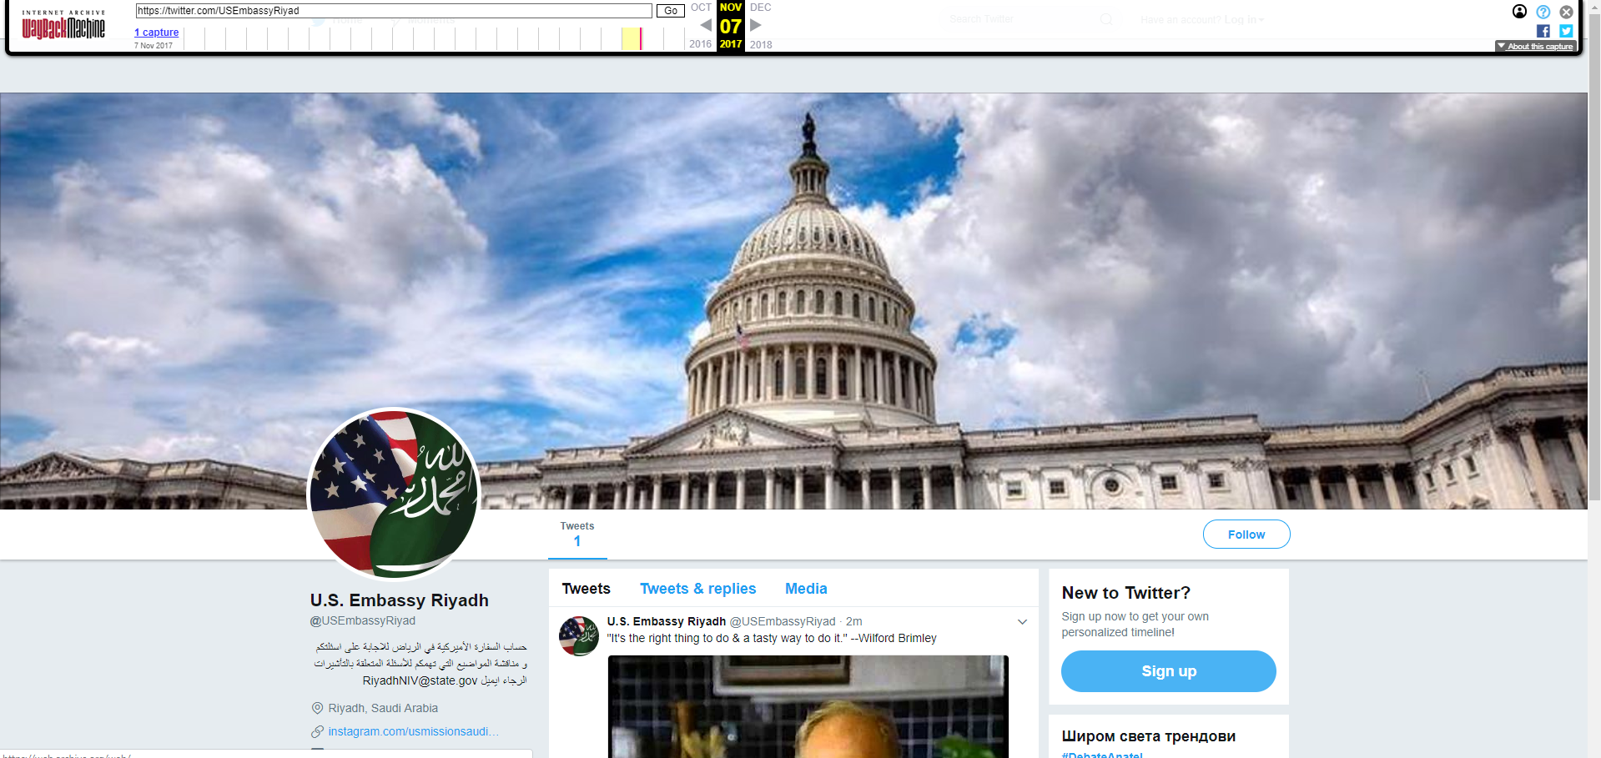
Littman’s Experiment
https://web.archive.org/web/20171107045700/https:/twitter.com/USEmbassyRiyad

Slide 17
Pointers – Real or an imposter?
Creation date of the account
Number of tweets/posts
Posted types of media and media itself
Check for the last activity if the account is dormant
If listed official, check homepage to confirm
Reverse Google image search the profile pics and banners
Are followers and commentators authentic

Slide 18
Facebook Internet Research Agency Ads
3,517 Facebook and Instagram ads were purchased and used during 2016 presidential elections
80,000 organic posts
Facebook submitted all the add in a PDF – difficult to extract
Digital archivist Ed Summers – created software to extract images and metadata from the PDF into JSON files (which can be used as a database to get the content)
Developer Simon Willison – wrote software to convert JASON files into searchable database

Slide 19
Williams & Kalvin account
Run by Russian manipulators
Posted content with YouTube, Facebook, and Twitter platforms as their main target
Initially posted about police brutality and racism to get more attention
Started posting anti-Clinton content towards the beginning of 2016 elections that drew attention

Slide 20
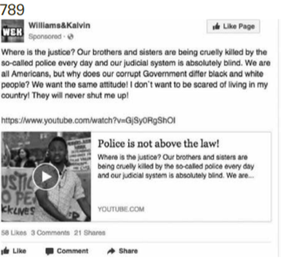
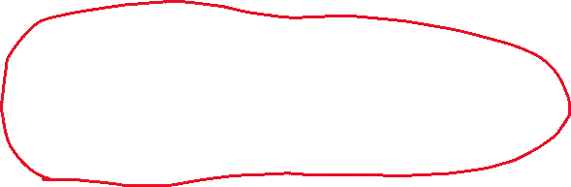
AD #789
Where is the Justice? Our brothers are being cruelly killed by the so-called police every day and our judicial system is absolutely blind. We are all Americans, but why does our corrupt Government differ black and white people? We want the same attitude! I don’t want to be scared of living in my country! They will never shut me up!
Targeting Interest matches and ethnic interested groups
Similar examples may include BlackNews.com or “HuffPost Black Voices” articles
Figure:7

Slide 21
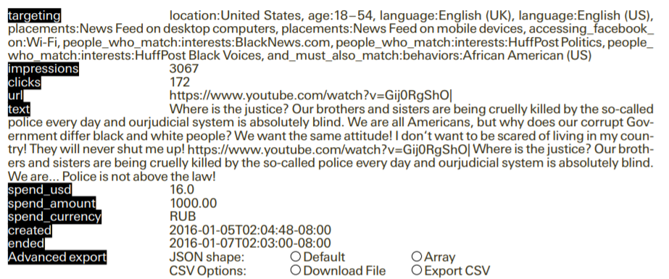
AD #789
Figure:8

Slide 22
Pointers
Account creation time and date and post rate per day would give a basic idea of the account authenticity
Search on platform’s policies on posts and ads
Uniqueness of the shared content gives information about how authentic the account is

Slide 23
Take away
With growing number of ways to detect, remove and prevent disinformation posts that manipulate, new methods of data craft as well grow in number
The core of all this is the metadata
Learning to read the metadata would help to discern the data craft
In each case, check for all the pointers before concluding the reason for the fake/disinformation

